Slide 1
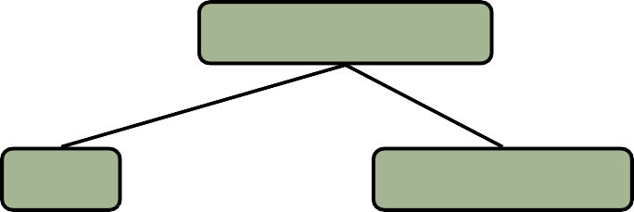
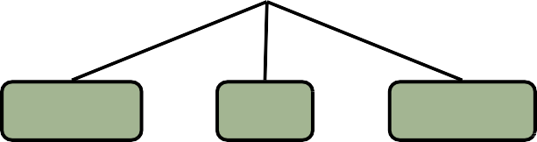
Trees
In computer science, a tree is a widely-used data structure that emulates a hierarchical tree structure with a set of linked nodes.
A tree is a finite nonempty set of elements.
It is an abstract model of a hierarchical structure.
consists of nodes with a parent-child relation.
Applications:
Organization charts
File systems
Computers Inc.
Programming environments
Sales
Manufacturing
R&D
US
International
Laptops
Desktops
2
Europe
Asia
Canada

Slide 2


Trees
Nature view
Computer view
leaves
Root
Leaves
Branches
Root
Branches
Nodes
3

Slide 3
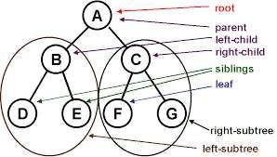








Tree terminologies
1
2
3
4
5
7
6
8
9
10
11

Slide 4
Tree terminologies
Path: Traversal from node to node along the edges results in a sequence calledpath.
Root: Node at the top of thetree.
Parent: Any node, except root has exactly one edge running upward to another node. The node above it is called parent.
Child: Any node may have one or more lines running downward to other nodes. Nodes below arechildren.
Leaf: A node that has nochildren.
Subtree: Any node can be considered to be the root of a subtree, which consists of its children and its children’s children and so on.

Slide 5
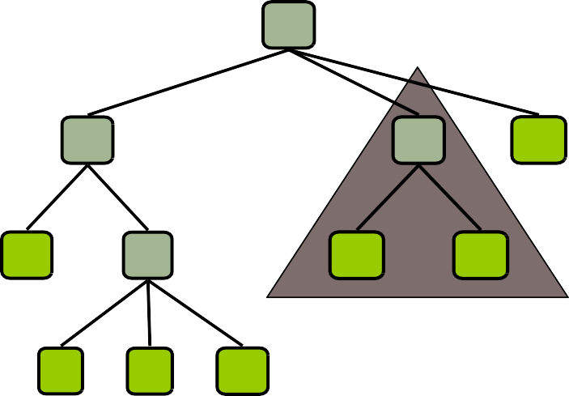
Tree terminologies
Root: node without parent (A)
Siblings: nodes share the same parent
Internal node: node with at least one child (A, B, C, F)
External node (leaf ): node without children(E,I,J,K,G,H,D)
Ancestors of a node: parent, grandparent, great-grandparent,etc.
Descendant of a node: child, grandchild, great-grandchild, etc.
Depth of a node: The root node has a depth of 0. Its direct children have a depth of 1.
Height of a tree: Leaf nodes have a height of 0. The height of a
non-leaf node is 1 plus the maximum of the heights of its children. Height of a tree is the height of a root node.
Degree of a node: the number of its children
Degree of a tree: the maximum number of its node.
A
B
C
D
E
F
G
H
6
I
J
K
subtree

Slide 6
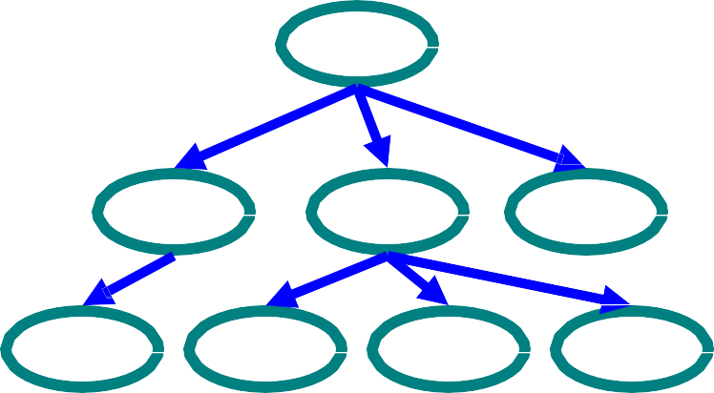
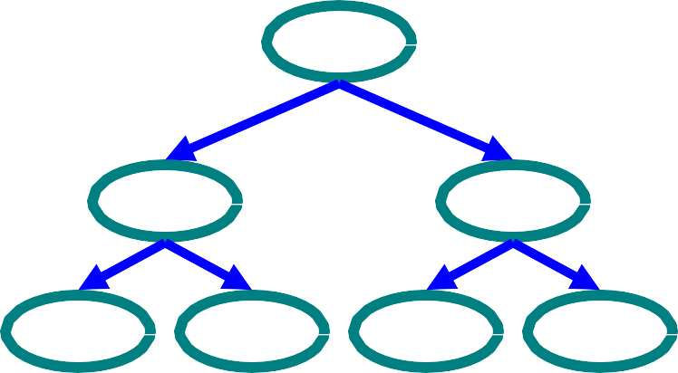
General trees and binary trees
Tree
Nodes
Each node can have 0 or more children
A node can have at most one parent
Binary tree
Tree with 0–2 children per node
7
Tree
Binary Tree

Slide 7
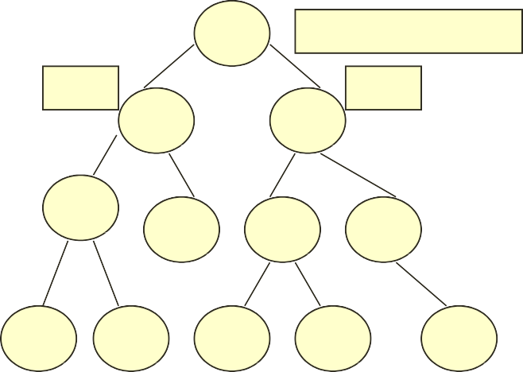
Binary trees
A binary tree is a data structure which is defined as a collection of elements called nodes.
In a binary tree, the topmost element is called the root node, and each node has 0, 1, or at the most 2 children.
Every node contains a data element, a "left" pointer which points to the left child, and a "right" pointer which points to the right child.
The root element is pointed by a "root" pointer.
If root = NULL, then it means the tree is empty.
A binary tree of height h has at least h nodes and at most 2^{h} – 1 nodes. This is because every level will have at least one node and can have at most 2 nodes.
The height of a binary tree with n nodes is at least log₂(n+1) and at most n.
1
ROOT NODE
T₁
T₂
2
3
R – Root node (node 1)
T₁- left sub-tree (nodes 2, 4, 5, 8, 9)
T₂- right sub-tree (nodes 3, 6, 7, 10, 11, 12)
4
8
5
6
7
8
9
10
11
12

Slide 8
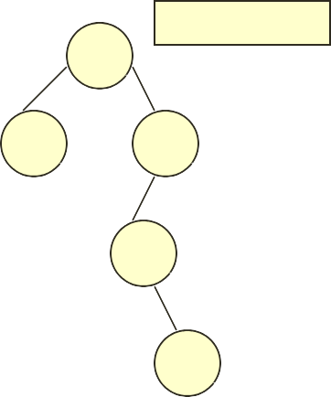
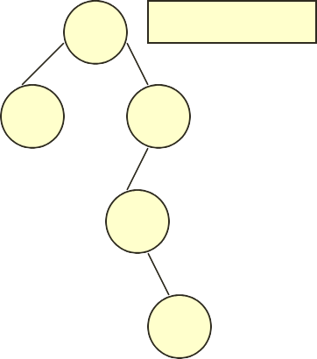
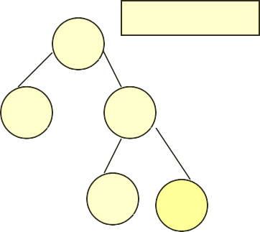
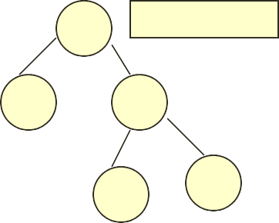
Binary trees
Similar binary trees: Given two binary trees T and T’ are said to be similar if both these trees have the same structure.
TREE T
A F
TREE T”
B
C
G
H
D
I
E J
Copies of binary trees: Two binary trees T and T’ are said to be copies if they have similar structure and same content at the corresponding nodes.
TREE T
TREE T”
A
A
B
C
B
C
9
D
E
D
E

Slide 9
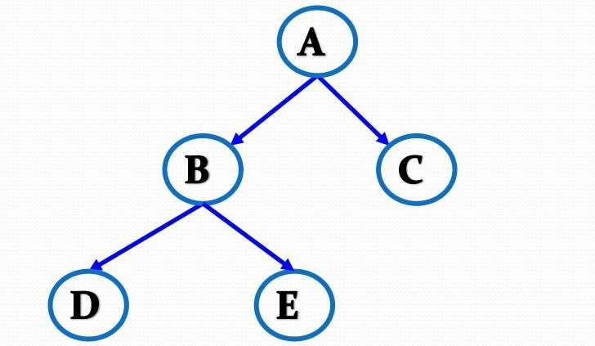
Strict / Proper / Full Binary Tree
A binary tree where every node has either 0 or 2 children.

Slide 10
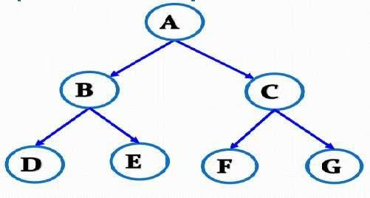
Perfect binary tree
A binary tree that has all nodes have 0 or 2 children and All leaves are at the same depth.

Slide 11
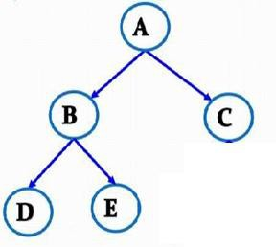
Complete/Almost complete binary tree
All levels are completely filled except possibly the last level, which is filled from left to right.

Slide 12
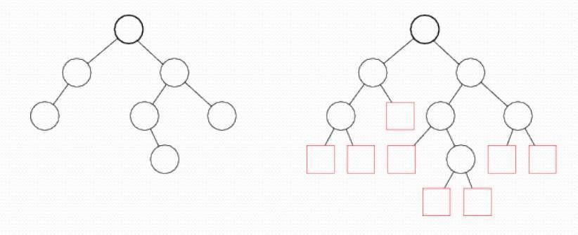
Extended binary tree
An extended binary tree is a transformation of any binary tree into a complete binary tree.
This transformation consists of replacing everynull subtree of the original tree with“special nodes.”
The nodes from the original tree are then called as internal nodes, while the “special nodes” are calledas external nodes.

Slide 13
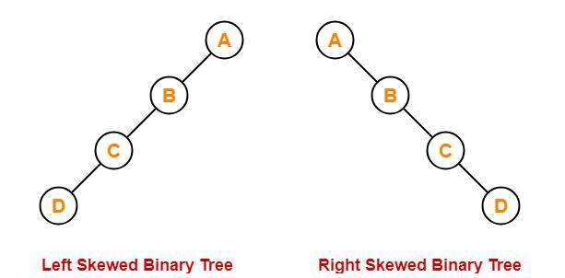
Skewed binary tree
A special case of a degenerate tree.
All nodes are strictly aligned to one side only:

Slide 14
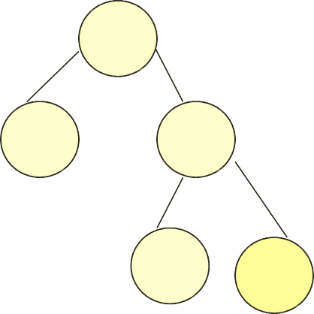
Array implementation of binary tree
If i=0 to n-1, then,
For PARENT with index (i)
LCH ILD (i) = 2i + 1
RCHILD (i) = 2i + 2
A
0
1
2
3
4
5
6
7
8
9
A | B | C | - | - | D | E | - | - | -
B
C
D
E

Slide 15
Array implementation of binary tree
Chapter 4
Advantages:
Any node can be accessed from any other node by calculating the index
Here, data are stored without any pointers to their successor or ancestor
Programming languages, where dynamic memory allocation is not possible (such as BASIC, FORTRAN), array representation is the only mean to store a tree
Disadvantages:
Other than full binary trees, majority of the array entries may be empty
Adding new node to it or deleting a node from it are inefficient with this representation, because these require considerable data, movement up and down the array which demand excessive amount of processing time
16

Slide 16
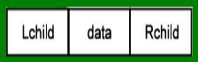
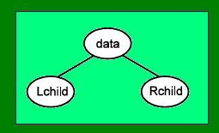
Linked implementation of binary tree
Binary tree has natural implementation in linked storage. In linked organization we wish that all nodes should be allocated dynamically
Hence we need each node with data and link fields
Each node of a binary tree has both a left and a right subtree
Each node will have three fields Lchild, Data, and Rchild. Pictorially this node is shown in Fig.
17

Slide 17
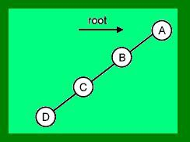
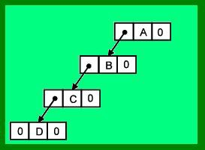
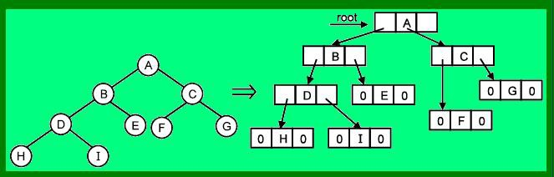
Linked implementation of binary tree
Figure ‘a’
18
Figure ‘b’

Slide 18
Linked implementation of binary tree
Advantages:
for unbalanced tree, memory is not wasted
Insertion and deletion operations are more efficient in this representation.
Disadvantages:
In this representation, there is no direct access to any node
It has to be traversed from root to reach to a particular node
As compared to sequential representation memory needed per node is more
19

Slide 19
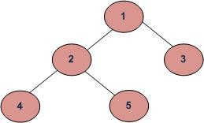
Tree traversal
Unlike linear data structures (Array, Linked List, Queues, Stacks, etc) which have only one logical way to traverse them, trees can be traversed in different ways.
Traversal is a process to visit all the nodes of a tree and may print their values too. Because, all nodes are connected via edges (links) we always start from the root (head) node.
That is, we cannot randomly access a node in a tree.
There are three ways which we use to traverse a tree
Inorder (Left, Root, Right) : 4 2 5 1 3
Preorder (Root, Left, Right) : 1 2 4 5 3
Postorder (Left, Right, Root) : 4 5 2 3 1

Slide 20
In-order traversal(L, V, R)
In this traversal method, the left subtree is visited first, then the root and later the right sub-tree.
We should always remember that every node may represent a subtree itself.
Until all nodes are traversed −
Step 1 − Recursively traverse left subtree.
Step 2 − Visit root node.
Step 3 − Recursively traverse rightsubtree.

Slide 21
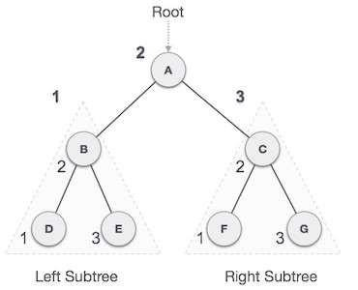
In-order traversal(L, V, R)
We start from A, and following in-order traversal, we move to its left subtree B. B is also traversed in-order. The process goes on until all the nodes are visited. The output of inorder traversal of this tree will be −
D → B → E → A → F → C →G

Slide 22
Pre-order traversal (V, L, R)
In this traversal method, the root node is visited first, then the left subtree and finally the right subtree.
Until all nodes are traversed −
Step 1 − Visit root node.
Step 2 − Recursively traverse left subtree.
Step 3 − Recursively traverse rightsubtree.

Slide 23
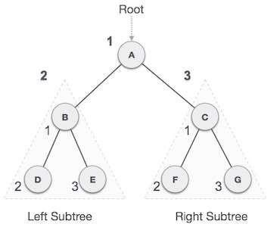
Pre-order traversal (V, L, R)
C
We start from A, and following pre-order traversal, we first visit A itself and then move to its left subtree B. B is also traversed pre-order. The process goes on until all the nodes are visited. The output of pre-order traversal of this tree will be.
A → B → D → E → C → F → G

Slide 24
Post-order traversal (L, R, V)
In this traversal method, the root node is visited last, hence the name. First we traverse the left subtree, then the right subtree and finally the root node.
Until all nodes are traversed
Step 1 − Recursively traverse left subtree.
Step 2 − Recursively traverse rightsubtree.
Step 3 − Visit root node.

Slide 25
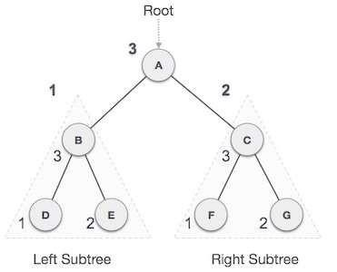
Post-order traversal (L, R, V)
We start from A, and following pre-order traversal, we first visit the left subtree B. B is also traversed post- order. The process goes on until all the nodes are visited. The output of post-order traversal of this tree will be.
D → E → B → F → G → C →A

Slide 26
Creation of binary tree using traversal
Binary tree can be constructed from combination of-
Preorder and Inorder traversal
Postorder and Inorder traversal
For given Preorder and Inorder traversal :
Scan Preorder traversal from L -> R
For each scanned node ‘X’, locate its position in Inorder traversal
The node preceding node ‘X’ in Inorder traversal forms the left subtree and node succeeding ‘X’ forms the right subtree
Repeat step 1 for each symbol in the preorder.
For Postorder and Inorder, the the last node will be the root node. (i.e., scan the Postorder traversal from R->L)
For each scanned node X, find its position in Inorder. In Inorder, the part before X = left subtree, and the part after X = right subtree.
27

Slide 27
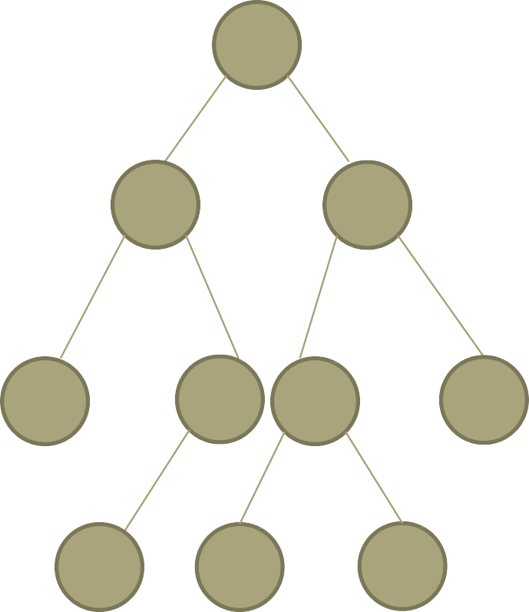
Preorder : ABDEHCFIJG
Inorder : DBHEAIFJCG
A
Inorder : DBHE Preorder : BDEH
Inorder : IFJCG Preorder : CFIJG
B
C
In: HE
Pre: EH
In : IFJ Pre : FIJ
D
E
F
G
H
I
J

Slide 28
Binary search tree (BST)
A binary search tree (BST), also known as an ordered binary tree, is a variant of binary tree in which the nodes are arranged in order.
In a BST, all nodes in the left sub-tree have a value less than that of the root node.
Correspondingly, all nodes in the right sub-tree have a value either equal to or greater than the root node.
The same rule is applicable to every sub-tree in the tree.
Due to its efficiency in searching elements, BSTs are widely used in dictionary problems where the code always inserts and searches the elements that are indexed by some key value.

Slide 29
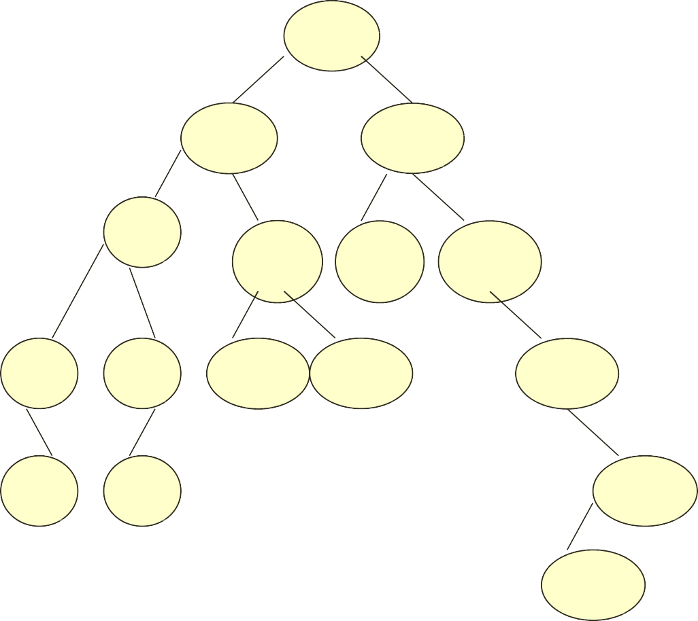
Binary search tree (BST)
39
27
45
18
29
40
54
9
21
28
36
59
10
19
65
60
30

Slide 30
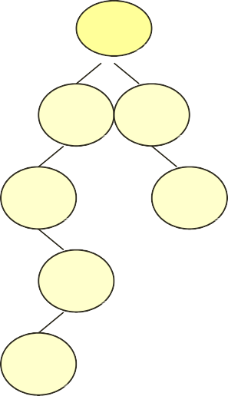
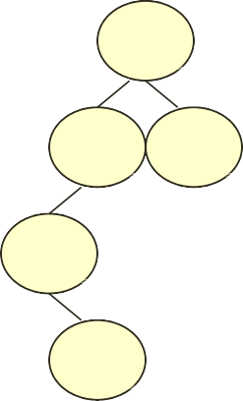
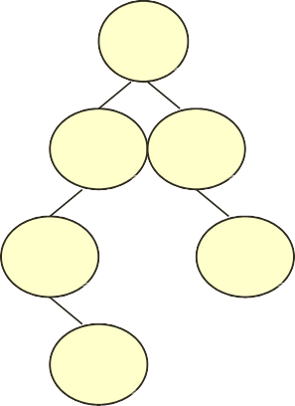

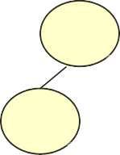
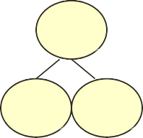
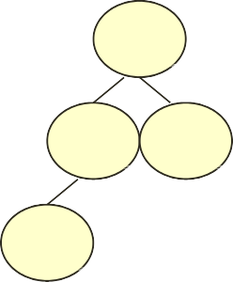
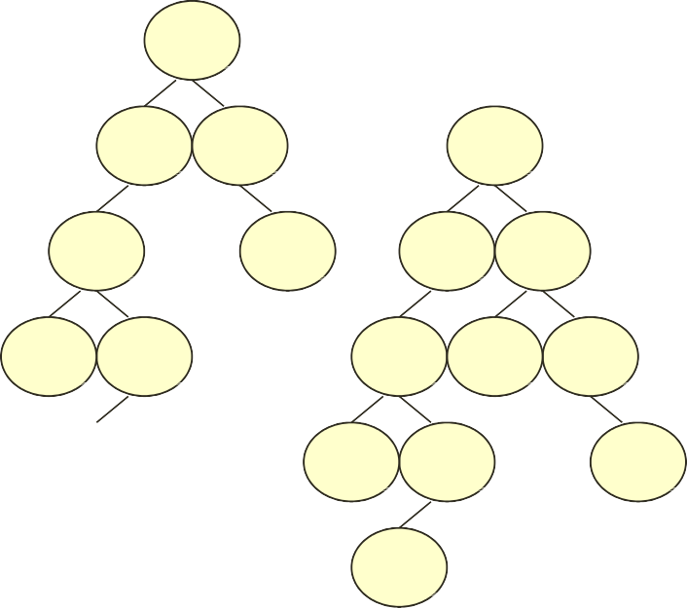
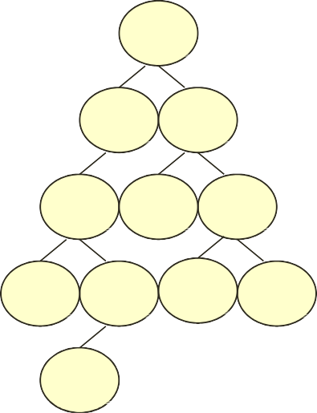

Creating BST from given value
45, 39, 56, 12, 34, 78, 32, 10, 89, 54, 67
45
45
45
45
45
45
45
39
56
39
56
39
56
39
39
56
39
56
12
78
12
12
78
12
34
45
34
34
32
39
56
45
45
12
78
39
56
39
56
10
34
12
54
78
12
54
78
31
32
10
34
89
10
34
67
89
32
32

Slide 31
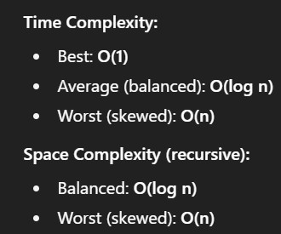
Algorithm to insert value in BST
Insert(TREE, VAL):
IF TREE = NULL THEN
Allocate memory for a new Node
Node->DATA = VAL
Node->LEFT = NULL
Node->RIGHT = NULL
RETURN Node
ELSE IF VAL < TREE->DATA THEN
TREE->LEFT = Insert(TREE->LEFT, VAL)
ELSE
TREE->RIGHT = Insert(TREE->RIGHT, VAL)
RETURN TREE

Slide 32
Searching a value in BST
The search function is used to find whether a given value is present in the tree or not.
The function first checks if the BST is empty. If it is, then the value we are searching for is not present in the tree, and the search algorithm terminates by displaying an appropriate message.
However, if there are nodes in the tree then the search function checks to see if the key value of the current node is equal to the value to be searched.
If not, it checks if the value to be searched for is less than the value of the node, in which case it should be recursively called on the left child node.
In case the value is greater than the value of the node, it should be recursively called on the right child node.

Slide 33
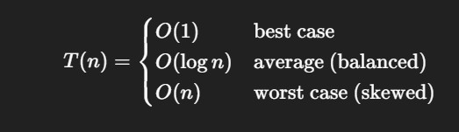

Algorithm to search a value in BST
searchElement (TREE, VAL)
IF TREE->DATA = VAL OR TREE = NULL
Return TREE
ELSE IF VAL < TREE->DATA
Return searchElement(TREE->LEFT, VAL)
ELSE
Return searchElement(TREE->RIGHT, VAL)
Average
Worst

Slide 34
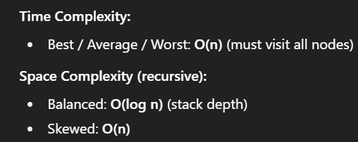
Determining height of BST
In order to determine the height of a BST, we will calculate the height of the left and right sub-trees. Whichever height is greater, 1 is added to it.
Height (TREE)
IF TREE = NULL, then
Return 0
Return
max(Height(tree->left),Height(tree->right))+1
35

Slide 35
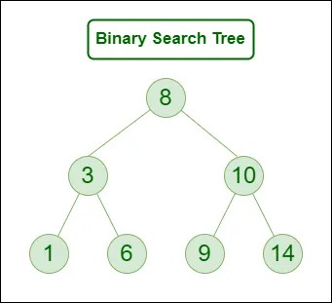
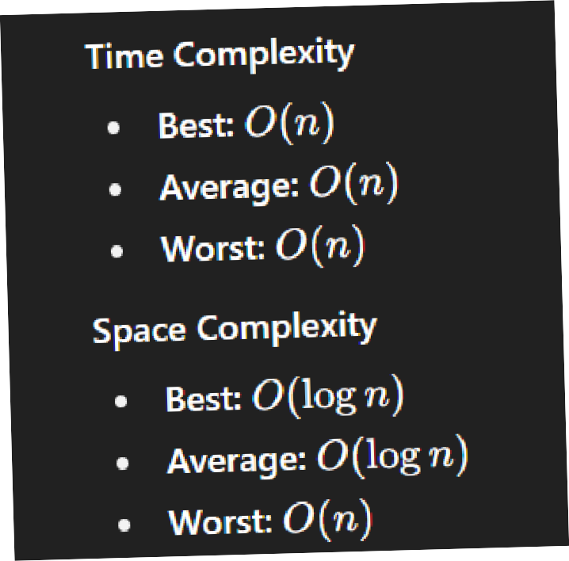
Determining number of nodes in BST
To calculate the total number of elements/nodes in a BST, we will count the number of nodes in the left sub-tree and the right sub- tree.
Number of nodes = totalNodes(left sub-tree) + total Nodes(right sub-
tree) + 1
Also Draw figure like this mor emore marks
returns 1
returns 1
totalNodes (TREE)
IF TREE = NULL
Return 0
Return totalNodes(TREE->LEFT)+totalNodes(TREE->RIGHT) + 1
36

Slide 36
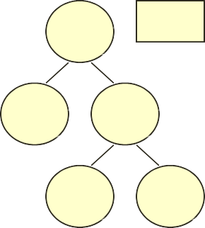
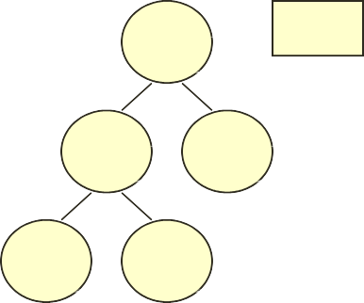
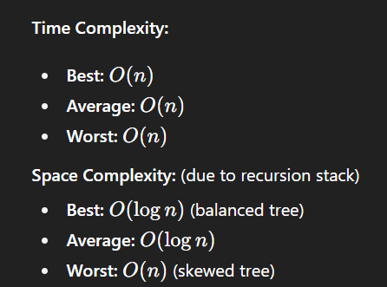
Finding mirror image of BST
Mirror image of a binary search tree is obtained by interchanging the left sub-tree with the right sub-tree at every node of the tree. For example, given the tree T, the mirror image of T can be obtained as T’.
T T’
45 45
39
78
78
39
54
79
79
54
MirrorImage(TREE):
IF TREE != NULL
MirrorImage(TREE->LEFT)
MirrorImage(TREE->RIGHT)
TEMP = TREE->LEFT
TREE->LEFT = TREE->RIGHT
TREE->RIGHT = TEMP
37

Slide 37
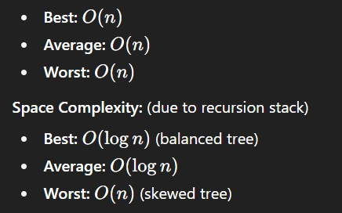
Deleting a BST
To delete/remove the entire binary search tree from the memory, we will first delete the elements/nodes in the left sub-tree and then delete the right sub-tree.
deleteTree (TREE):
IF TREE != NULL , then
deleteTree (TREE->LEFT) deleteTree (TREE->RIGHT) Free (TREE)
3
8

Slide 38
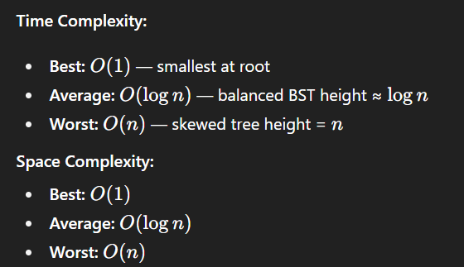
Finding smallest node in BST
The basic property of a BST states that the smaller value will occur in the left sub-tree.
If the left sub-tree is NULL, then the value of root node will be smallest as compared with nodes in the right sub-tree.
So, to find the node with the smallest value, we will find the value of the leftmost node of the left sub-tree.
However, if the left sub-tree is empty then we will find the value of the root node.
findSmallestElement (TREE):
IF TREE = NULL OR TREE->LEFT = NULL
Return TREE
Return findSmallestElement(TREE->LEFT)
39

Slide 39
Deleting a value/node from a BST
The delete function deletes a node from the binary search tree.
However, care should be taken that the properties of the BSTs do not get violated and nodes are not lost in the process.
The deletion of a node involves any of the three cases.
Deleting a node that has no children.
Deleting a node that has one child.
Deleting a node that has both children.
40

Slide 40
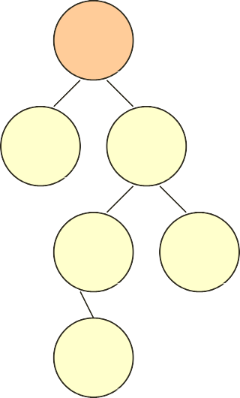
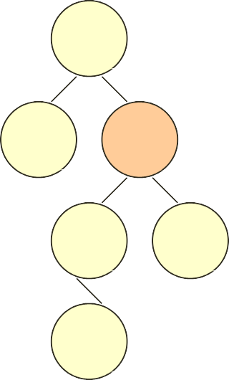
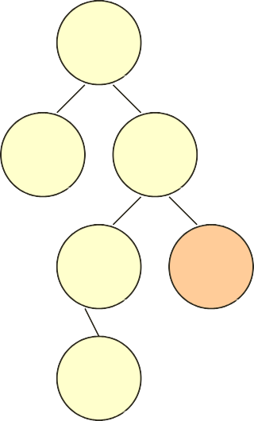
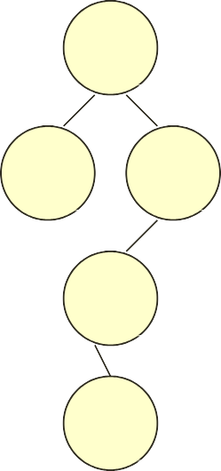
Deleting a value/node from a BST
Case 1: Deleting a node that has no children.
Just remove / disconnect the leaf node that is to deleted from the tree.
For example, deleting node 78 in the tree below.
45
45
45
45
39
56
39
56
39
56
39
56
54
78
54
78
54
78
54
55
55
55
55
41

Slide 41




Deleting a value/node from a BST
Case 2: Deleting a node with one child (either left or right).
To handle the deletion, the node’s child is set to be the child of the node’s parent.
45
39
56
39
56
39
56
39
56
42
54
78
54
78
54
78
55
78
55
55
55

Slide 42


Deleting a value/node from a BST
Case 3: Deleting a node with two children.
To handle this case of deletion, replace the node’s value with its in- order predecessor (largest value in the left sub-tree) or in-order successor (smallest value in the right sub-tree).
The in-order predecessor or the successor can then be deleted using any of the above cases.
For example, deleting node 56 in the tree below.
45 45 45
45
39
56
39
56
39
55
39
55
43
54
78
54
78
54
78
54
78
55
80
55
80
55
80
80

Slide 43




23
23
18
44
19
44
12
20
35
52
12
20
35
52
19
22
19
22
Using smallest node in the right subtree
23
23
18
44
12
44
12
20
35
52
12
20
35
52
19
22
19
22
44
Using largest node in the left subtree

Slide 44

Algorithm to delete
Delete(TREE, VAL):
IF TREE = NULL THEN
PRINT "VAL not found"
RETURN
ELSE IF VAL < TREE->DATA
TREE->LEFT = Delete(TREE->LEFT, VAL)
ELSE IF VAL > TREE->DATA
TREE->RIGHT = Delete(TREE->RIGHT, VAL)
ELSE // Node with value VAL found
// Case 1: Node has both left and right children
IF TREE->LEFT != NULL AND TREE->RIGHT != NULL
TEMP = findLargestNode(TREE->LEFT) // predecessor
TREE->DATA = TEMP->DATA
TREE->LEFT = Delete(TREE->LEFT, TEMP->DATA)
ELSE // Node 0 or one child
TEMP = TREE
IF TREE->LEFT = NULL AND TREE->RIGHT = NULL
TREE = NULL
ELSE IF TREE->LEFT != NULL
TREE = TREE->LEFT
ELSE
TREE = TREE->RIGHT
DELETE TEMP
RETURN TREE
45

Slide 45
Expression trees
A special kind of binary tree in which:
Each leaf node contains a single operand
Each non-leaf node contains a single binary operator
The left and right subtrees of an operator node represent subexpressions that must be evaluated before applying the operator at the root of the subtree.
The levels of the nodes in the tree indicate their relative precedence of evaluation (we do not need parentheses to indicate precedence).
Operations at higher levels of the tree are evaluated later than those below them.
46
• The operation at the root is always the last operation performed.

Slide 46
Expression trees
‘*’
‘+’
‘3’
‘4’
‘2’
What value does it have?
( 4 + 2 ) * 3 = 18
47

Slide 47
Expression trees
‘*’
‘-’
‘/’
‘8’
‘5’
‘+’
‘3’
‘4’
‘2’
Infix:
Prefix:
( ( 8 - 5 ) * ( ( 4 + 2 ) / 3 ) )
* - 8 5 / + 4 2 3
48
• Postfix:
8 5 - 4 2 + 3 / *

Slide 48
Creating expression tree from postfix expression
Read the expression one symbol at a time.
If the symbol is an operand,
we create a one-node tree and push a pointer to it onto a stack.
If the symbol is an operator,
we pop (pointers) to two trees T1 and T2 from the stack (T1 is popped ﬁrst) and form a new tree whose root is the operator and whose left and right children point to T2 and T1, respectively.
A pointer to this new tree is then pushed onto the stack.

Slide 49






Construct expression tree for ab+cde+**

Slide 50
Applications of trees
Trees are used to store simple as well as complex data. Here simple means an int value, char value and complex data (structure).
Trees are often used for implementing other types of data structures like hash tables, sets, and maps.
A self-balancing tree, Red-black tree is used in kernel scheduling to preempt massively multi-processor computer operating system use.
Another variation of tree, B-trees are used to store tree structures on disc. They are used to index a large number of records.
B-trees are also used for secondary indexes in databases, where the index facilitates a select operation to answer some range criteria.
Trees are used for compiler construction.
Trees are also used in database design.
Trees are used in file system directories.
Trees are also widely used for information storage and retrieval in symbol tables.
51

Slide 51
Huffman tree and its application
Developed by David A. Huffman in 1952 A.D.
Huffman tree is a strict binary tree with minimum weighted path length.
One of the most important applications of binary tree is in Communication .
Used in lossless data compression that uses variable length encoding for a character based on its estimated probability of occurrence.

Slide 52

Huffman tree
For a strictly binary tree, for ‘n’ leaves/external nodes, there will be total 2n-1 nodes.
External nodes = Internal nodes +1
External path length (L_{E}) = sum of all path to leaves
= 2+2+2+3+3 = 12
Internal path length (L_{I}) = sum of all path to int. nodes
=0+1+1+2 = 4
Hence, L_{E} = L_{I} + 2n_{i}

Slide 53



Huffman tree
If external nodes have weight ‘W’, then weighted path length will be,
•
=1
Since, P = W₁L₁ + W₂L₂ +….. W_{n}L_{n}
Lets assume weight be 2, 7, 9, 10 . Then tree can be,
a. c.
b.
2
10
9
9
7
10
2 9
7
P_{a} = 2*2 + 7*2 + 9*2 + 10*2 = 56
P_{b} = 2*1 + 7*3 + 9*2 + 10*3 = 71
P_{c} = 2*3 + 7*3 + 9*2 + 10*1 = 55
10
7
2
54

Slide 54
Huffman tree
That means, we can create different forms of tree for same given weights.
Path length of those trees will be different .
Although the tree structures are same, path length can differ (as in b. and c.)
Solution for this problem is creating a Huffman tree to find
minimum path length.
55

Slide 55
Huffman tree (Algorithm)
For the ‘n’ external nodes with W_{n} weights , Huffman algorithm is,
1. Suppose there are ‘n’ weights W₁, W₂, ……. , W_{n}
2. Create a priority queue for it In which highest priority is given to lowest weight (optional).
3. Take two minimum weighted nodes to form a new node(for e.g., if W₁ and W₂ are minimum weighted nodes, they will form a new node W₁ + W₂)
4. Now , add new node , say W₁ + W_{2 ,} to the queue so that remaining nodes will be W₁ + W₂ , W₃, ….. , W_{n}
5. Create all subtree at last weight.
This is bottom up approach to create a tree
Here , the leaves contains actual characters and internal nodes stores the weight and link to the child nodes.
56

Slide 56



Huffman tree (Example)
Create a Huffman tree with the following nodes.
Solution: 1.
2.
3.
57

Slide 57



4.
5.
6.
58

Slide 58



7.
8.
9.
59

Slide 59
Huffman coding
It is a variable length coding based on estimated probability of occurrence of each possible value of source character
If 26 character set (of alphabets) is to be represented in binary code, then , we need 2⁵<26<2⁴ i.e., 5 bits
It will be inefficient if all character uses 5-bit representation ( fixed length coding)
So, the character with highest probability of occurrence is assigned less number of bits in variable length coding
For Huffman coding:
1. Generate a Huffman tree.
2. Every left branch is coded with ‘0’ and right branch with ‘1’
3. To generate code, visit root to leaf through coded branch.
60

Slide 60


0
211
1
0
1
1
0
0
1
0
1
0
1
1
0
0
1
1
0
A(7) = 01000
B(9) = 01001
C(11) = 1000
D(14) = 1001
E(18) = 0101
F(21) = 101
G(27) = 000
H(29) = 001
I(35) = 011
J(40) = 11
61

Slide 61
Balanced binary trees
The disadvantage of a binary search tree is that its height can be as large as N-1
This means that the time needed to perform insertion and deletion and many other operations can be O(N) in the worst case
We want a tree with small height
A binary tree with N node has height at least Ө(log N)
Thus, our goal is to keep the height of a binary search tree O(log N)
Such trees are called balanced binary search trees. Examples are AVL tree, red-black tree.
62

Slide 62
AVL Trees
AVL tree is a self-balancing binary search tree in which the heights of the two sub-trees of a node may differ by at most one. Because of this property, AVL tree is also known as a height-balanced tree.
The key advantage of using an AVL tree is that it takes O(logn) time to perform search, insertion and deletion operations in average case as well as worst case (because the height of the tree is limited to O(logn)).
63

Slide 63
AVL Trees
The structure of an AVL tree is same as that of a binary search tree but with a little difference. In its structure, it stores an additional variable called the BalanceFactor.
The balance factor of a node is calculated by subtracting the height of its right sub-tree from the height of its left sub-tree.
Balance factor = Height (left sub-tree) – Height (right sub-tree)
A binary search tree in which every node has a balance factor of -1, 0 or 1 is said to be height balanced. A node with any other balance factor is considered to be unbalanced and requires rebalancing.
64

Slide 64



AVL Trees
1
0
0
0
1
-1
0
0
0
0
AVL Tree
2
AVL Tree
-1
0
0
1
65
0
Not an AVL Tree

Slide 65
AVL Trees
If the balance factor of a node is 1, then it means that the left sub-tree of the tree is one level higher than that of the right sub-tree. Such a tree is called Left-heavy tree.
If the balance factor of a node is 0, then it means that the height of the left sub-tree is equal to the height of its right sub-tree.
If the balance factor of a node is -1, then it means that the left sub-tree of the tree is one level lower than that of the right sub-tree. Such a tree is called Right-heavy tree.
66

Slide 66



AVL Trees
Left heavy AVL tree
1
Balanced AVL tree
45
1
0
45
36
63
0
0
36
0
0
63
1
27
0
0
0
39
54
72
0
27
0
39
54
72
0
0
18
Right heavy AVL tree
-1
45
0
-1
36
63
0
0
0
1
27
39
54
72
67
0
70

Slide 67
Searching in AVL Tree
Searching in an AVL tree is performed exactly the same
way as it is performed in a binary search tree.
Because of the height-balancing of the tree, the search operation takes O(log n) time to complete.
Since the operation does not modify the structure of the tree, no special provisions need to be taken.
68

Slide 68
Insertion in AVL Tree
Since an AVL tree is also a variant of binary search tree(BST), insertion is also done in the same way as it is done in case of a BST.
Like in BST, the new node is always inserted as the leaf node. But the step of insertion is usually followed by an additional step of rotation.
Rotation is done to restore the balance of the tree. However, if insertion of the new node does not disturb the balance factor, that is, if the balance factor of every node is still -1, 0 or 1, then rotations are not needed.
69

Slide 69
Insertion in AVL Tree
During insertion, the new node is inserted as the leaf node, so it will always have balance factor equal to zero.
The nodes whose balance factors will change are those which lie on the path between the root of the tree and the newly inserted node.
The possible changes which may take place in any node on the path are as follows:
Initially the node was either left or right heavy and after insertion has become balanced.
Initially the node was balanced and after insertion has become either left or right heavy.
Initially the node was heavy (either left or right) and the new node has been inserted in the heavy sub-tree thereby creating an unbalanced sub-tree. Such a node is said to be a critical node.
70

Slide 70
Rotations to balance AVL Tree
To perform rotation, our first work is to find the critical node. Critical node is the nearest ancestor node on the path from the root to the inserted node whose balance factor is neither -1, 0 nor 1.
The second task is to determine which type of rotation has to be done.
There are four types of rebalancing rotations and their application depends on the position of the inserted node with reference to the critical node.

Slide 71
Rotations to balance AVL Tree
LL rotation: the new node is inserted in the left sub-tree of the left sub-tree of the critical node
RR rotation: the new node is inserted in the right sub- tree of the right sub-tree of the critical node
LR rotation: the new node is inserted in the right sub- tree of the left sub-tree of the critical node
RL rotation: the new node is inserted in the left sub-tree of the right sub-tree of the critical node

Slide 72

LL Rotation
Imbalance occurs when new node is inserted at left of left subtree of critical node.
Perform single clockwise(right ) rotation.
During rotation :
Replace A by B by rotating clockwise rotation along B.[A <- B]
Attach A as right subtree of B. [ right(B) <- A]
Re-attach right-subtree B_{R} of B as left-subtree of A. [left(A) <- B_{R}]

Slide 73



LL Rotation
Example: Consider the AVL tree given below and insert 9 into it.
1
1
4
1
5
1
4
5
3
6
6
3
0
3
6
6
3
0
1
0
0
0
2
7
2
7
3
9
5
4
7
2
3
9
5
4
7
2
0
0
0
9
1
8
0
0
1
8
0
0
2
The tree is balanced using LL rotation
2
4
5
3
6
6
3
0
2
0
2
7
3
9
5
4
7
2
1
0
74
1
8
0
0
9

Slide 74

RR Rotation
Imbalance due to insertion of new node at right of right subtree of critical node.
Perform single counter-clockwise (left) rotation
During rotation :
Replace A by B by rotating counter-clockwise rotation along B.[A <- B]
Attach A as left subtree of B. [ left(B) <- A]
Re-attach left-subtree B_{L} of B as right-subtree of A. [right(A) <- B_{L}]
75

Slide 75



RR Rotation
Example: Consider the AVL tree given below and insert 91 into it.
-1
-1 45
4
5
0
0
-1
-1
36
63
3
6
6
3
0
0
0
0
27
27
-1
39
54
8
9
0
3
9
5
4
72
0
0
0
54
91
0
8
9
0
The tree is balanced using RR rotation
-2
0
4
5
3
6
6
3
-2
0
2
7
3
9
5
4
7
2
-2
0
-1
76
8
9
0
9
1

Slide 76

LR Rotation
Imbalance due to insertion of new node at right sub-tree of left child of critical node.
Perform double rotation - RR (along B) followed by LL (along A) rotation.
During rotation :
Right (B) <- left (C )
left(A) <- right (C)
Left (C) <- B
Right (C) <-A

Slide 77



Slide 78

RL Rotation
Imbalance due to insertion of new node at left sub-tree of right child of critical node.
Perform double rotation - LL (along B) followed by RR (along A) rotation.
During rotation :
Right (A) <- left (C )
left(B) <- right (C)
Left (C) <- A
Right (C) <- B

Slide 79



Slide 80

Construct an AVL tree for following data: 30, 31, 32, 23, 22, 28, 24, 29, 26, 27, 34, 36.

Slide 81


Slide 82


Slide 83
Deletion in AVL tree
Deletion of a node in an AVL tree is similar to that of BST.
But deletion may disturb the AVLness of the tree, so to re- balance the AVL tree we need to perform rotations.
There are two classes of rotation that can be performed on an AVL tree after deleting a given node: R rotation and L rotation.
If the node to be deleted is present in the left sub-tree of the critical node, then L rotation is applied else if node is in the right sub-tree, R rotation is performed.
Further there are three categories of L and R rotations. The variations of L rotation are: L-1, L0 and L1 rotation. Correspondingly for R rotation, there are R0, R-1 and R1 rotations.
84

Slide 84



R0 Rotation
Used when BF of left subtree of critical node is 0.
Node to be deleted is at the right subtree of critical node.
Subtree height is unchanged.
No further adjustments to be done.
Similar to LL rotation.
During rotation :
Critical node(A) <- B
Right (B) <- A
B_{R} <- left(A) A
B 0
1
A
2
B
-1
A_{R}
B 0
A’_{R}
B_{L}
1
A
85
-1
B_{L} B_{R}
Before deletion.
B_{L} B_{R}
B_{R} A’_{R}
h h-1
After rotation.
After deletion.

Slide 85



Consider the given AVL tree and delete 72 from it.
1
0
45
36
63
-1
1
27
-1
72
39
0
0
2
18
40
0
0
45
36
63
0
Before deletion.
1
27
39
-1
0
0
18
40
After deletion.
-1
1
36
27
45
1
0
-1
18
0
86
39
63
After rotation.
0
40

Slide 86



R1 Rotation
Used when BF of left subtree of critical node is 1.
Node to be deleted is at the right subtree of critical node.
Subtree height is reduced by 1.
Must continue on path to root.
Similar to LL and R0 rotations.
During rotation :
Critical node(A) <- B
Right (B) <- A
B_{R} <- left(A)
 | A | 1 |  |  | A | 2 |  | B | 0
B | 1 |  | A | B | 1 |  | A’_{R} h-1 | B_{L}
B_{L} |  | B_{R-} |  | B_{L} |  | B_{R-} |  |  | B_{R} h-1
87
_{h}R
0 A
A’_{R}
h-1
Before deletion.
After deletion.
After rotation.

Slide 87




Consider the given AVL tree and delete 72 from it
1
1
45
36
63
1
1
27
0
39
72
0
0
2
18
Before deletion.
1
45
36
63
0
1
27
39
After deletion.
0
0
18
0
36
1
27
45
0
88
0
0
0
18
39
63
After rotation.

Slide 88



R-1 Rotation
Used when BF of left subtree of critical node is -1.
Node to be deleted is at the right subtree of critical node. ^{A}
1
B
-1
A_{R}
Subtree height is reduced by 1.
Must continue on path to root.
Similar to LR.
B_{L}
b
C
C_{L}
Before deletion.
C_{R}
During rotation :
A
2
Critical node(A) <- C
Right(C)<- A
Left (C)<- B
Right(B)<-C_{L}
Left(A) <- C_{R}
C
0
B
-1
A’
R
B
A
B_{L}
b
C
89
B_{L} C_{L}
After rotation.
C_{R}
A’_{R}
h-1
C_{L}
After deletion.
C_{R}

Slide 89

Consider the given AVL tree and delete 72 from it
1
-1
45
36
63
-1
0
0
0
27
39
72
0
0
2
37
41
-1
45
Before deletion.
36
63
0
0
0
27
39
0
0
1
After deletion.
37
41
39
1
36
45
1
1
0
0
90
27
37
41
63
After rotation.
0

Slide 90
L0, L1 and L-1 Rotations
Used when BF of right subtree of critical node is either 0, 1 or -1 and node to be deleted will be at left subtree of critical node.
LO ≡ RR rotation
L1 ≡ RL rotation
L-1 ≡ RR rotation
91

Slide 91
M-Way Search Trees
Tree whose out degree is not restricted to 2 while retaining the general properties of binary search trees.
Each node has m - 1 data entries and m subtree pointers.
The key values in a subtree
>= the key of the left data entry
< the key of the right data entry.
K₁ K₂ K₃
92
keys < K₁
K₁<= keys < K₂
K₂<= keys < K₃
K₃<= keys

Slide 92
M-Way Search Trees
50
100
150
35
45
85
95
125
135
175
60
70
90
110
120
75
93

Slide 93
B-Trees
M-way trees are unbalanced.
Bayer, R. & McCreight, E. (1970) created B-Trees.
A B-tree is a specialized m- way tree that is widely used for disk access. A B tree of order m can have maximum m-1 keys and m pointers to its sub-trees. A B-tree may contain a large number of key values and pointers to sub-trees. Storing a large number of keys in a single node keeps the height of the tree relatively small.
P₀ | K₀ | P₁ | K₁ | P₂ | K₂ | …… … | ^{P}n-1 | ^{K}n-1 | P_{n}
In the structure, P0, P1, P2,…, Pn are pointers to the node’s sub-trees and K0, K1, K2,…, Kn-1 are the key values of the node. All the key values are
94
stored in ascending order. That is, Ki < Ki+1 for 0 ≤ i ≤ n-2.

Slide 94
B-Trees
A B-tree is designed to store sorted data and allows search, insert, and delete operations to be performed in logarithmic amortized time. A B-tree of order m (the maximum number of children that each node can have) is a tree with all the properties of an m-way search tree and in addition has the following properties:
Every node in the B-tree has at most (maximum) m children.
Every node in the B-tree except the root node and leaf nodes have at least (minimum) m⁄2 children. This condition helps to keep the tree bushy so that the path from the root node to the leaf is very short even in a tree that stores a lot of data.
The root node has at least two children if it is not a terminal (leaf) node.
All leaf nodes are at the same level.
An internal node in the B tree can have n number of children, where 0 ≤n
≤ m. it is not necessary that every node has the same number of children, but the only restriction is that the node should have at least m/2 children.
95

Slide 95


B-Trees
In summary, a B-tree is an m-way tree has following properties:
The root is either a leaf or has at least 2 and at most m subtrees.
All internal nodes have at least [m/2] and at most m subtrees.
A leaf node has at least [m/2] - 1 and at most m - 1 entries.
All leaf nodes are at the same level.
42
16 20
58 76 81 93
11 14
17 18 19
21 22 23 24
45 52
63 65 74 78 79 85 87 94 9₉7₆
M=5

Slide 96
Insertion in B-tree
Find the leaf where the key should go.
If leaf is not full → insert key in sorted order.
If leaf is full →
Insert key in order,
Split the node at the median,
Push the median up to the parent (split parent if needed).

Slide 97
Example: Look at the B tree of order 5 given below and insert 8, 9, 39 into it.
O | 18 | O | 45 | O | 72 | O
O
7
O
11
O
O
21
O
27
O
3
O
42
O
O | 81 | O | 89 | O | 90 | O
O
54
O
63
O
O | 18 | O | 45 | O | 72 | O
O | 7 | O | 8 | O | 1 1 | O
O | 21 | O | 27 | O | 36 | O | 42 | O
O | 54 | O | 63 | O
O | 81 | O | 89 | O | 90 | O
O | 18 | O | 45 | O | 72 | O
O | 81 | O | 89 | O | 90 | O
O | 7 | O | 8 | O | 9 | O | 1 1 | O
O | 2 | O | 2 | O | 3 | O | 4 | O
 | 1 |  | 7 |  | 6 |  | 2
O | 5 | O | 6 | O
 | 4 |  | 3
O | 18 | O | 36 | O | 45 | O | 72 | O
O
81
O
89
O
90 O
O | 7 | O | 8 | O | 9 | O | 1 1 | O
O | 21 | O | 27 | O
O | 39 | O | 42 | O
O | 54 | O | 63 | O

Slide 98


B-Tree Insertion (example)
Insert 78
78
Insert 21
21 78
Insert 14, 11
11 14 21 78
Insert 97
21
11 14 21 78 97
overflow
Insert 85, 74, 63
11 14
78 97
 |  | 21 |  |  |  |  |  |  |  | 21 | 78
11 | 14 |  | 63 | 74 | 78 | 85 | 97 | 11 | 14 | 63 | 74 | 85 | 97
overflow
99

Slide 99






Insert 45, 42, 57
21 78
11 14 42 45 57 63 74
21 57 78
85 97
11 14
42 45
63 74
85 97
overflow
Insert 20, 16, 19
21 57 78
16 21 57 78
11 14 16 19 20
overflow 42
63 74
85 97
11 14
19 20
63 74
85 97
45
42 45
Insert 52, 30, 21
16 21 57 78
11 14 19 20 63 74
21 30 42 45 52
42
16 21
57 78
85 97
11 14
21 30
45 52
85 97
100
19 20
63 74
overflow

Slide 100
Deletion in B-Tree
1. Locate the leaf node which has to be deleted
2. If it is leaf node :
If the leaf has more than the minimum keys → just delete.
Else (underflow) →
Borrow a key from left/right sibling if possible.
Otherwise, merge with sibling and pull down parent key (may propagate upward).
3. If it is internal node:
Replace the key with its predecessor (from left subtree) or successor (from right subtree).
Then delete that predecessor/successor from the leaf (handled by case 2).
101

Slide 101
Consider the B tree of order 5 given below and delete the values- 93, 201 from it.
O
108
O
O | 117 | O | 201 | O
O
63
O
81
O
 |  |  |  |  |  |  |  |  |  |  |  |  |  |  |  |  |  | O |  | 151 | O |  | 180 |  |  | O
O | 36 | O |  | 45 |  | O
 |  |  |  |  |  |  |  |  | O |  | 90 | O | 93 | O | 101 |  | O
 |  |  |  |  |  |  |  |  |  |  |  |  |  |  |  |  |  |  |  |  |  |  |  | O | 243 |  |  | O |  | 256 |  | O | 333 |  | O | 450 | O
 |  |  | O |  | 72 |  | O | 79 |  | O
 |  |  |  |  |  |  |  |  |  |  |  |  |  |  |  | O |  |  | 111 |  |  | O |  |  |  |  | 114 |  |  |  | O
O
108
O
O | 117 | O | 243 | O
O | 63 | O | 81 | O
O | 151 | O | 180 | O
O | 36 | O | 45 | O
O | 90 | O | 101 | O
O
256
O
333
O
450
O
O | 1 1 | O | 1 1 | O
 | 1 |  | 4
O | 72 | O | 79 | O

Slide 102

B-Tree Deletion
Delete 78
63
63
11 14 21
74 78 85
11 14 21
74 85
Delete 63
63
21
11 14 21
74 85
11 14
74 85
104

Slide 103
B-Tree Deletion
Delete 85
21
21
11 14
74 85
11 14
74
underflow
(node has fewer than the minimum no. of entries)
Delete 21
21
14
11 14
74 85
11
74 85
105
For each node to have sufficient number of entries:
– Balance: shift data among nodes.

Slide 104



Balance
Borrow from right
...
21
...
when the right
sibling of the underflow node has more than minimum no. of entries
Original node
14
42 45 63
21
Rotate parent data down
14
21
42 45 63
Rotate data to
42
parent
14
21
42 45 63
Shift entries
42
106
left
14
21
45
63

Slide 105




Balance
Borrow from left
...
78
...
when the left sibling of the underflow node has more than minimum no. of entries
Original node
45
63
74
85
...
78
...
Shift entries right
45
63
74
85
12 42
8 9
14
45 63
Rotate parent data down
...
78
...
45
63
74
78 85
Rotate data
...
74
...
107
up
45
63
78
85

Slide 106



Combine
when both left and right sibling nodes of the underflow nodes have minimum no. of entries
 |  | 12 | 42 |  |  |  |  | 12
8 | 9 | 14 |  | 45 | 63 | 8 | 9 | 14 | 42 | 45 | 63
choose one of its sibling
move the separator down to the underflow node
12
8 9 14
42
45 63
combine the underflow node with the chosen sibling
if the parent node is underflow, repeat this combination until the root.
108

Slide 107
Red Black Tree
1. Every node is either RED or BLACK.
2. The root node is always BLACK.
3. Every leaf node is BLACK.
4. If a node is RED, then both of its children are BLACK.
(No two RED nodes appear consecutively on any path.)
5. For each node, all paths from that node to its NULL descendants
contain the same number of BLACK nodes (Black-Height Property).
109

Slide 108

Red Black Tree
9
2
7
7
11
21
4
5
NULL
11
NULL
NULL
NULL
NULL
3
6
6
3
NULL
NULL
NULL
NULL
NULL
NULL
110

Slide 109

9
2
7
7
11
21
4
5
110
NULL
11
NULL
NULL
NULL
NULL
3
6
6
3
NULL
NULL
NULL
NULL
NULL
NULL

